Slide 1

Credit Card Clustering
PRESENTATIONS!
EDA and vizualizaions
Notes:
To use this title animation slide with a new image simply 1) move the top semi-transparent shape to the side, 2) delete placeholder image, 3) click on the picture icon to add a new picture, 4) Move semi-transparent shape back to original position, 5) Update text on slide.

Slide 2
1-EDA

Slide 3
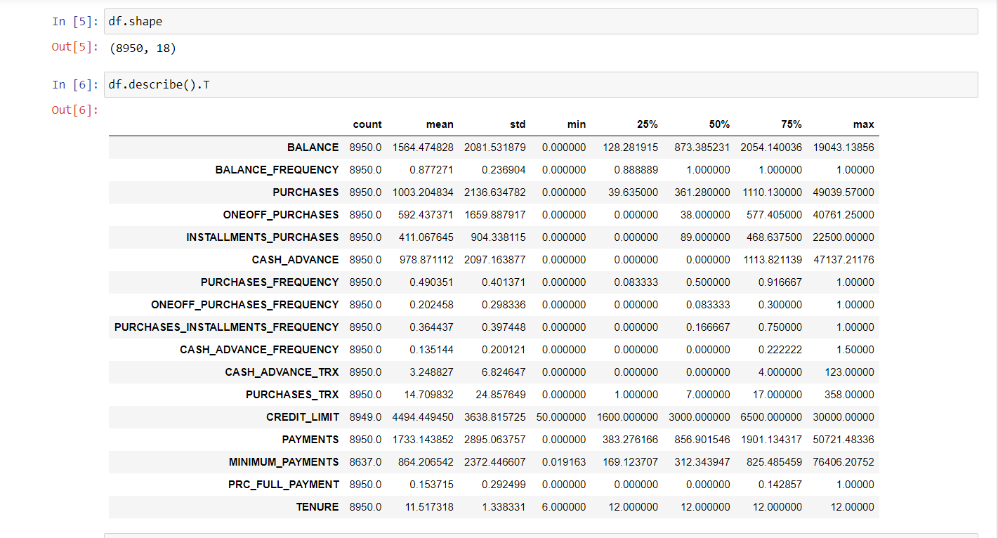
Let’s Get some information about the data

Slide 4
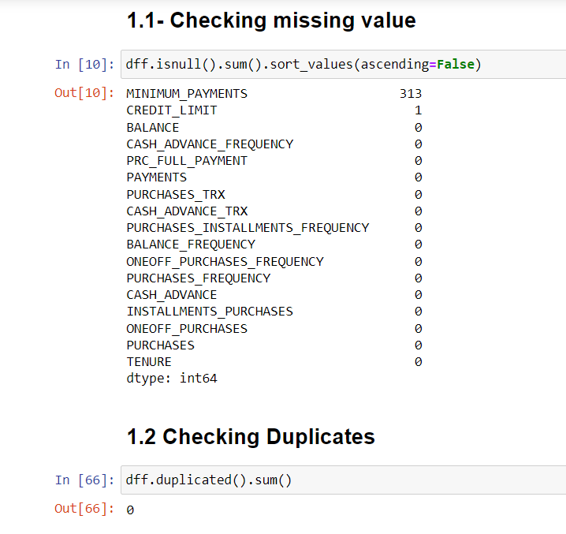
Checking Missing values and duplicates
There’s no duplicated data and few missing values in “Minimum payments column”

Slide 5
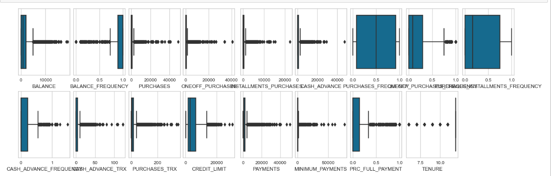
Checking outliers
Almost all columns have outliers

Slide 6
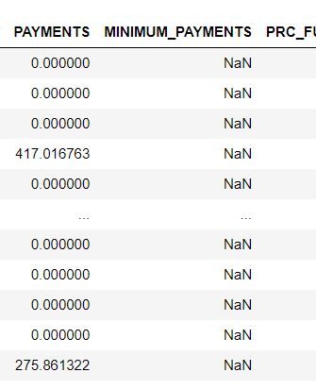

What about null values?
Almost all The values of “Payments” columns = 0 so can replace all this null values in “Minimum Payments“ column with zero.

Slide 7
2-PREPROCESSING

Slide 8
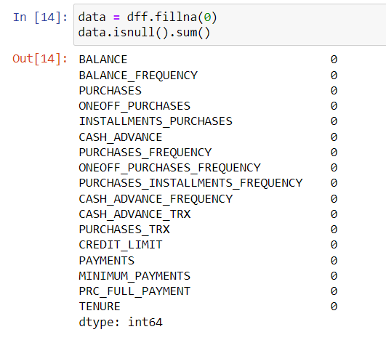
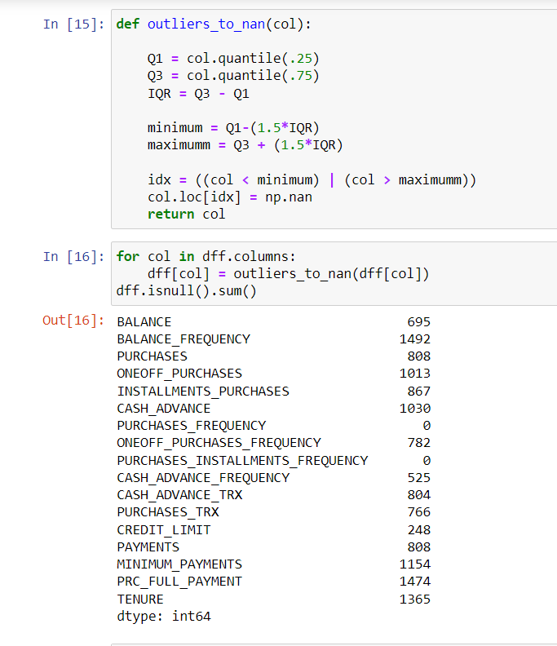
2.1- handling missing values and outliers we Tried 2 methods
2- transform all outliers to nans and impute them using KNN imputer
(Way 2)
1- replace Nan with Zeros
(Way 1)

Slide 9
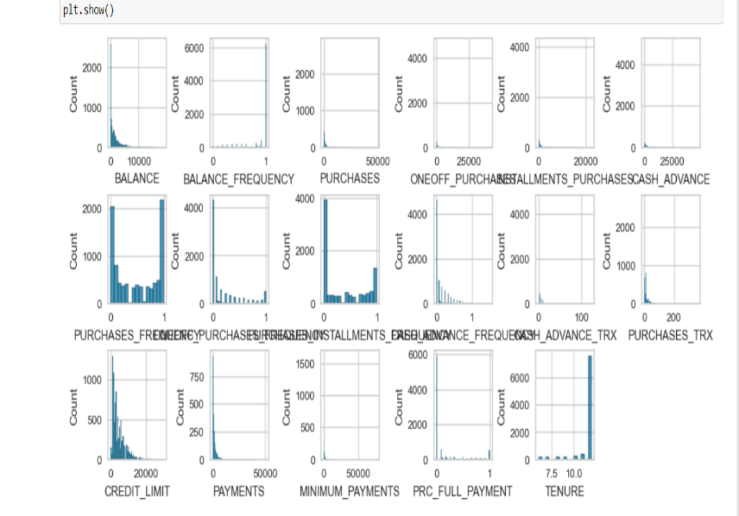
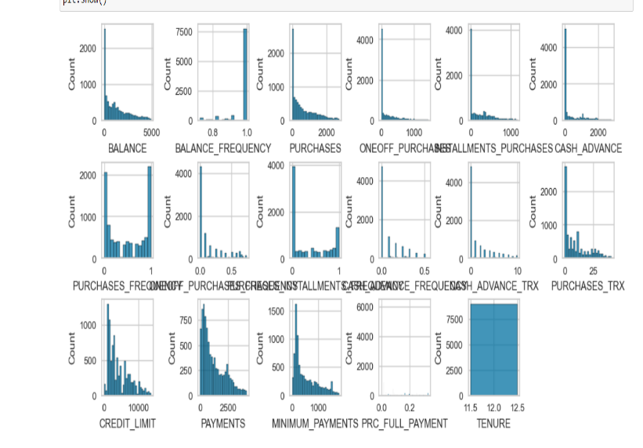
2.2- ScalingThe data
Distribution of the data
After way 1 Fill by 0
After way 2 imputer:
Most of Data right Skewed

Slide 10
2.2.1 Scaling using Standard scaler

Slide 11
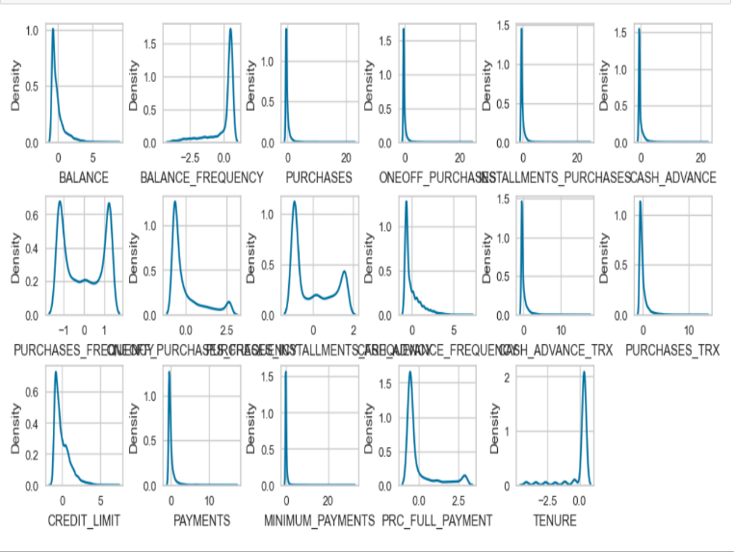
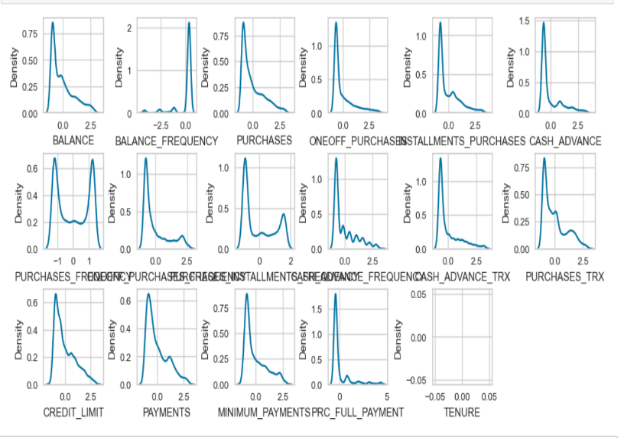
2.2.1-Distribution of The Data with STD
After way1 of handling Nan values and STD
After way2 of handling Nan values and STD
The data is almost still right skewed
Still little skewed but better

Slide 12
2.3 Dimensionally reduction

Slide 13
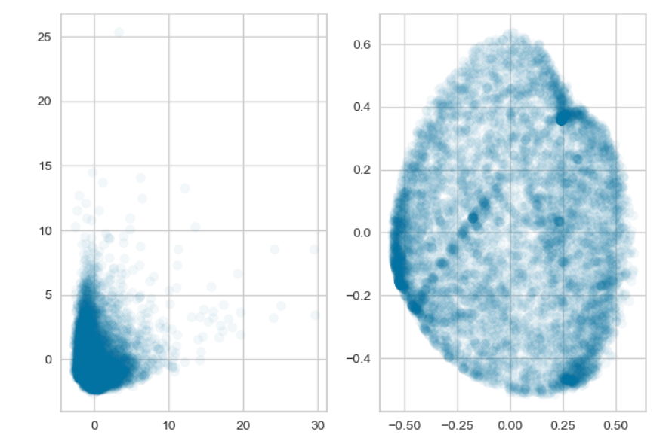
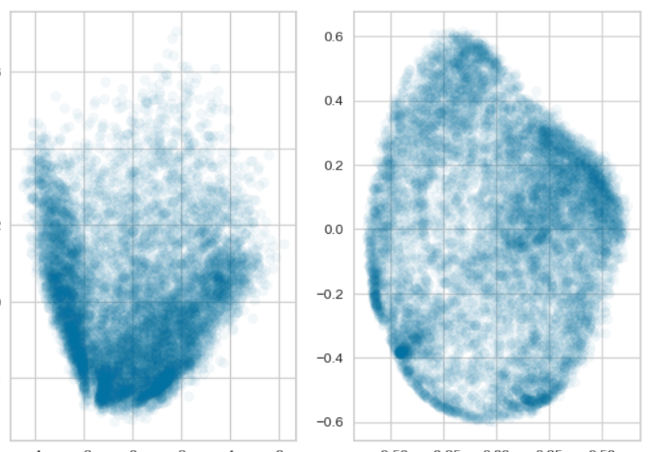
PCA vs Kernel-PCA
With way 1
With way 2
PCA and PCA looks good so will try both

Slide 14
3-Modeling

Slide 15
3.1 KMeans

Slide 16
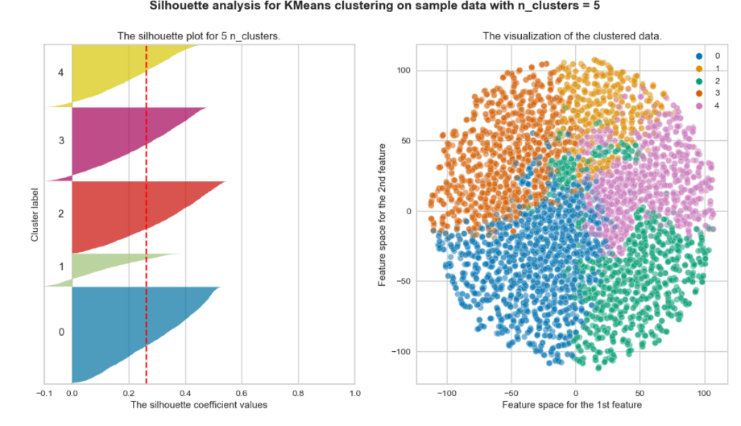
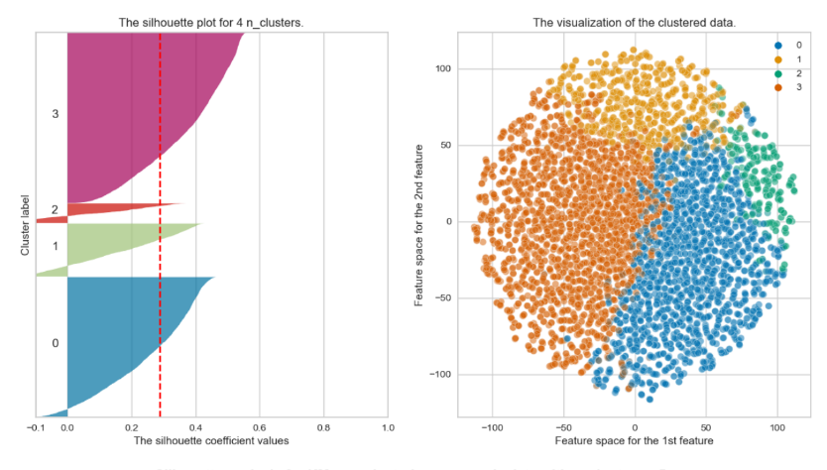
With PCA
Way 2
Way 1
4 clusters With Score: 28.8
5 clusters With Score: 26.1

Slide 17
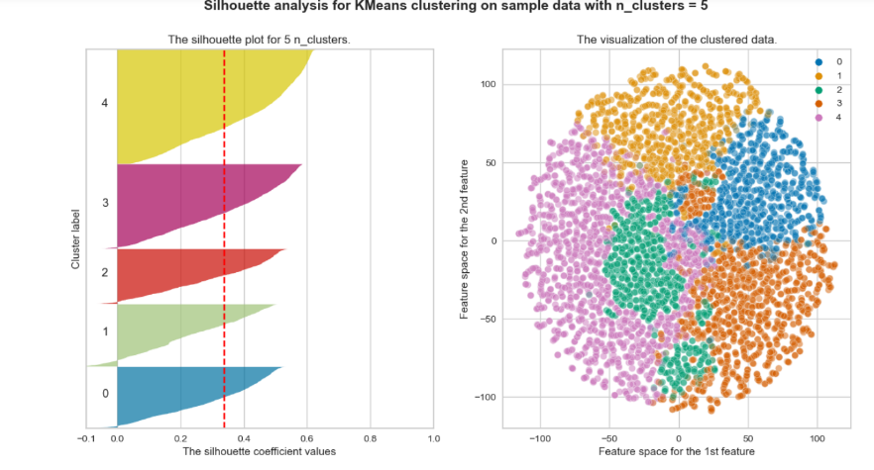
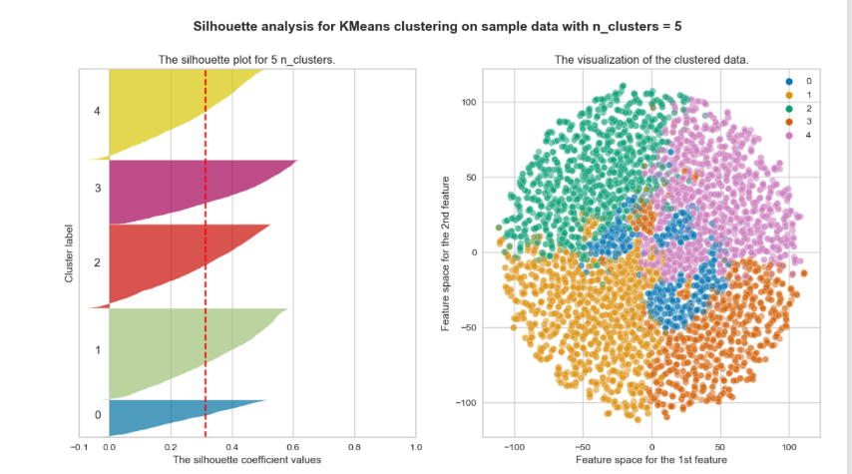
With Kernel PCA
Way 2
Way 1
5 clusters With Score: 33.7
5 clusters With Score: 31.4

Slide 18
3.2 AgglomerativeClustering

Slide 19
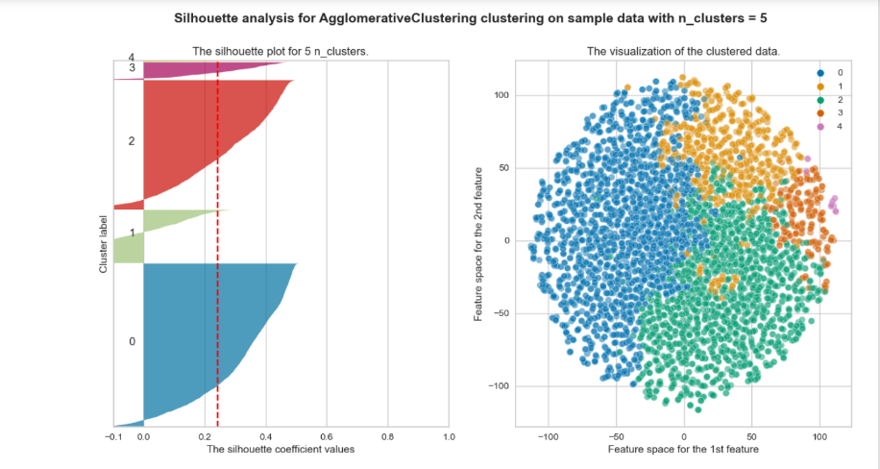
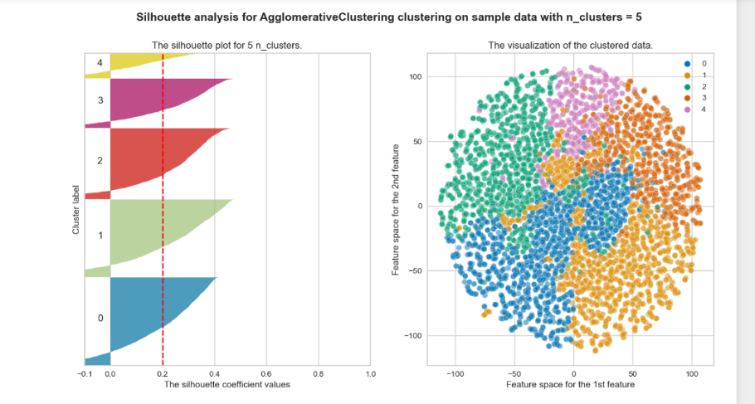
With PCA
Way 2
Way 1
5 clusters With Score: 24.1
5 clusters With Score: 20.2

Slide 20
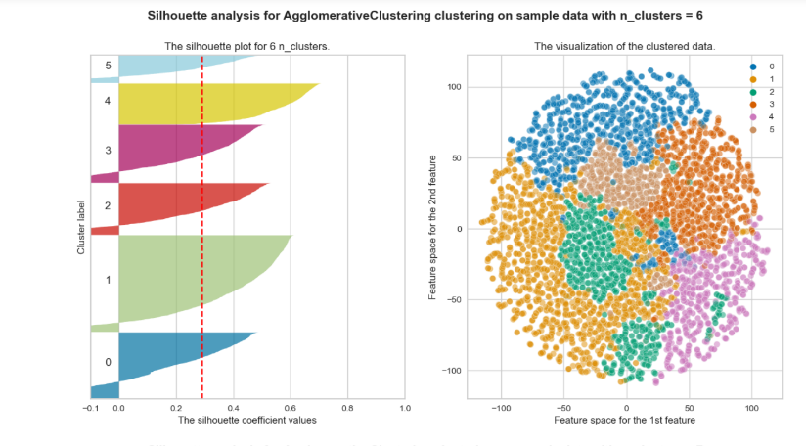
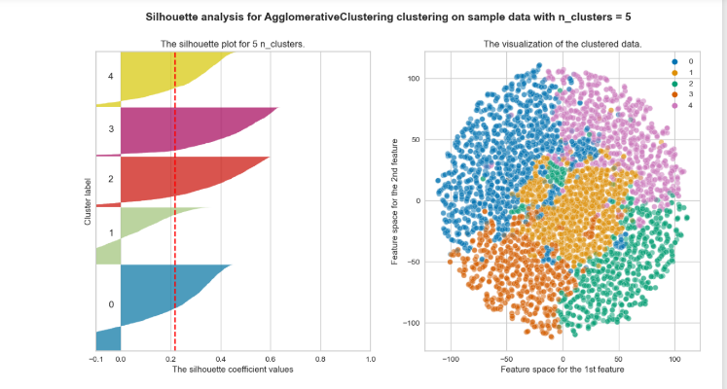
With Kernel PCA
Way 2
Way 1
6 clusters With Score: 29.1
5 clusters With Score: 21.6

Slide 21
3.3 Gaussian Mixture

Slide 22
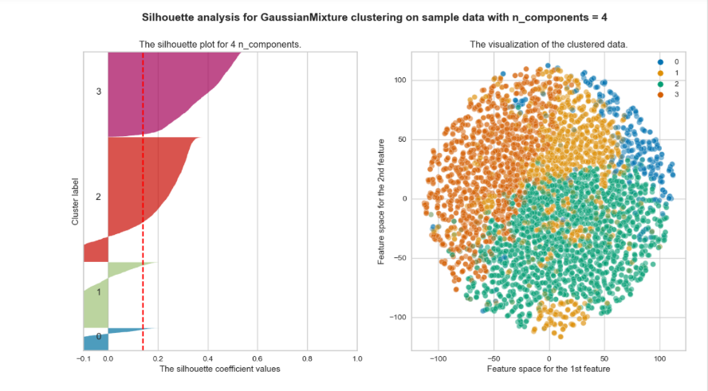
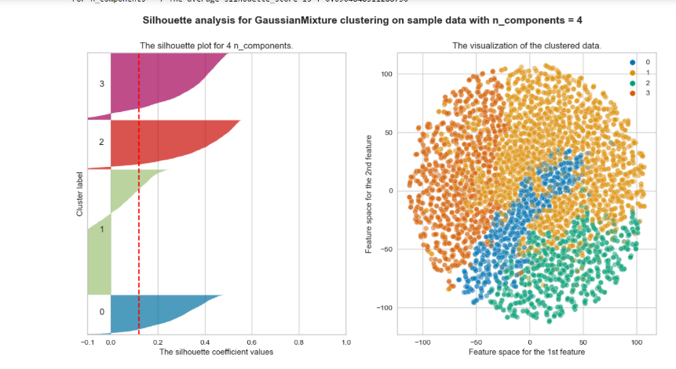
With PCA
Way 2
Way 1
4 clusters With Score: 12.0
4 clusters With Score: 13.9

Slide 23
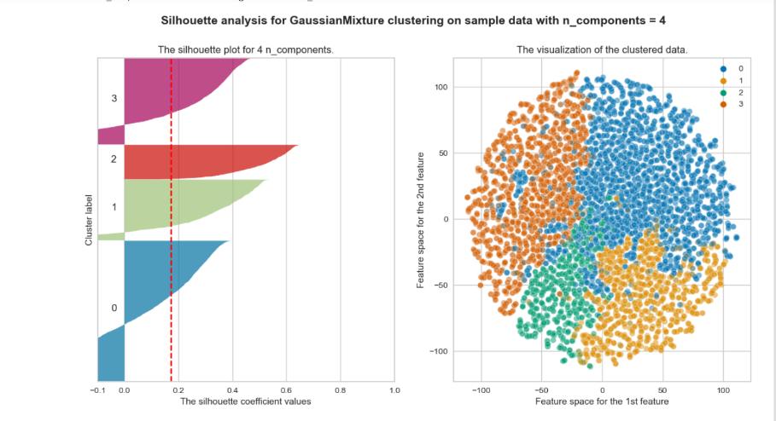
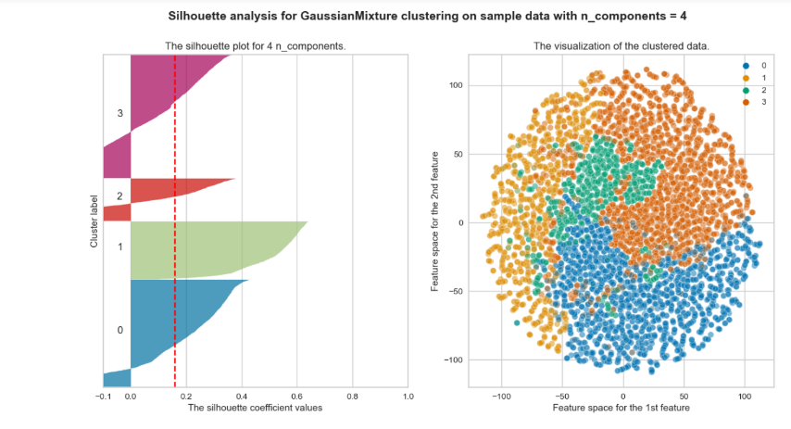
With Kernel PCA
Way 2
Way 1
4 clusters With Score: 16.0
4 clusters With Score: 17.2

Slide 24
3.3 Mean shift

Slide 25
With PCA
The number of cluster more than 1000

Slide 26
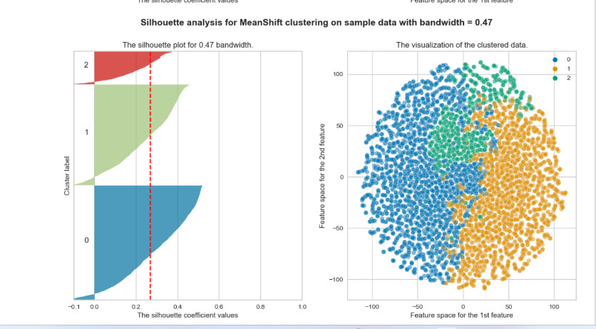
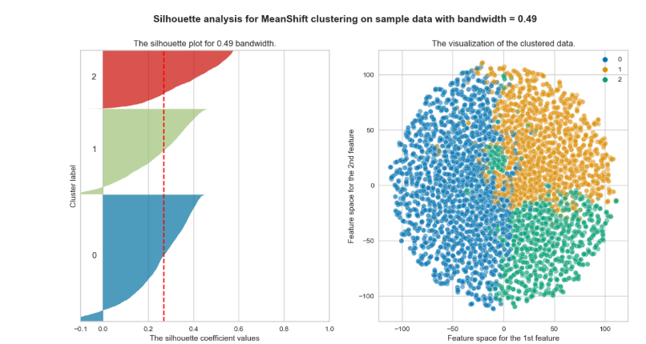
With Kernel PCA
Way 2
Way 1
.47 Bandwidth With Score: 26.9
.49 Bandwidth With Score: 26.8

Slide 27
3.3 DBSCAN

Slide 28
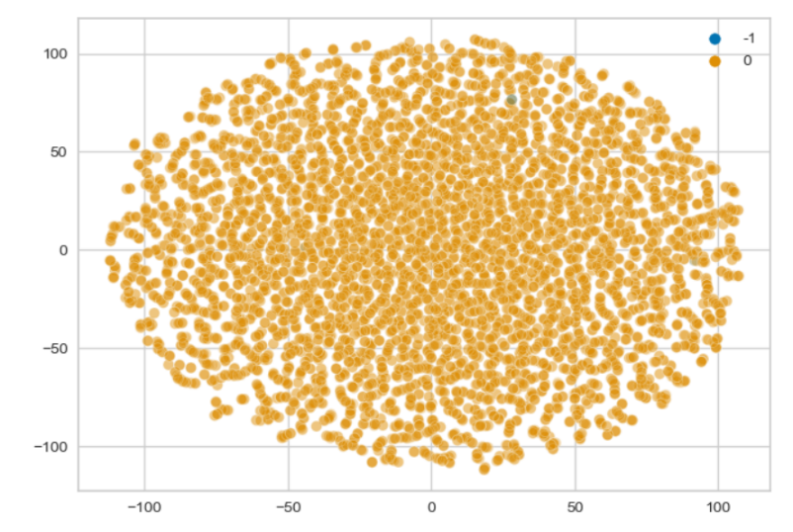
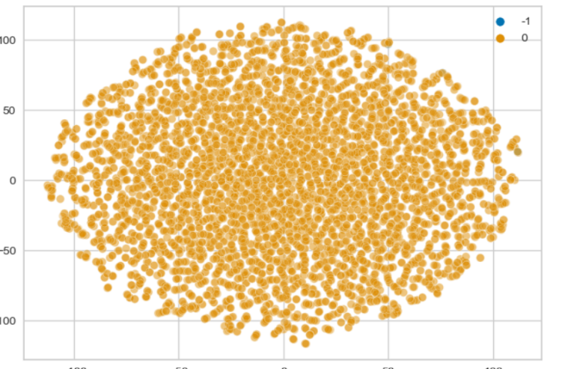
With PCA
Having one cluster with very high silhouette score may cause overfitting
Way 2
Way 1
EPS = 7.49, min_samples =2 and k =2 with score = 85.4
EPS = 1.9, min_samples =2 and k =2 with score = 37.6

Slide 29
With Kernel PCA
The score of DBSCAN is so bad , it’s less than zeros

Slide 30

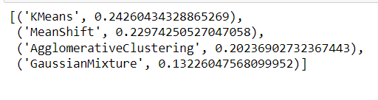
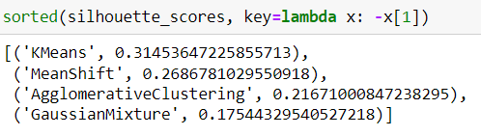
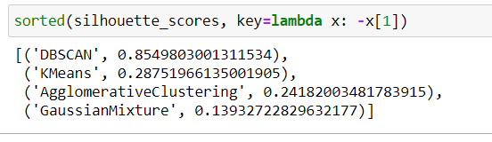
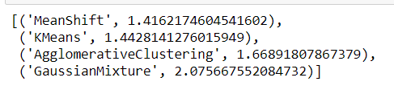
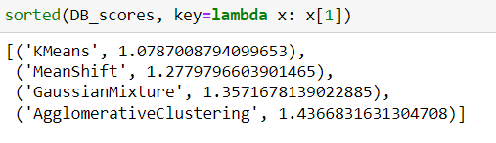
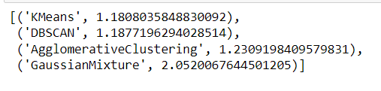
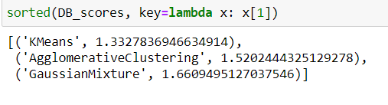
So What Best Model for STD scaler?
Silhouette score vs Davies-Bouldin
Silhouette must be large and DB must be small for the best model
Way 2 with Kernel-PCA
Way 1 with PCA
Way 2 with PCA
Way 1 with Kernel-PCA
WINNER models: KMEANS KMEANS KMEANS KMEANS

Slide 31
Conclusion
In way 1: The scores with PCA more than scores with K-PCA and the BEST model for this way is KMEANS
In way 2: The scores with K-PCA more than scores with PCA and the BEST model for this way is KMEANS
The Best model is KMEANS with silhouette score 31.4 and davies_bouldin score = 1.07

Slide 32
2.2.2 Power Transformer

Slide 33
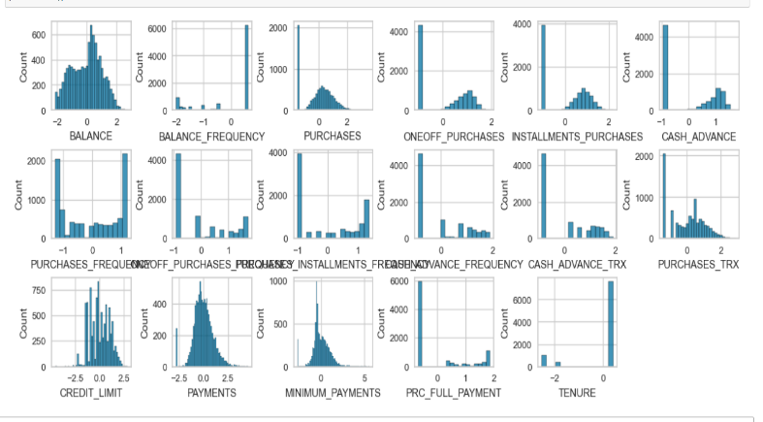
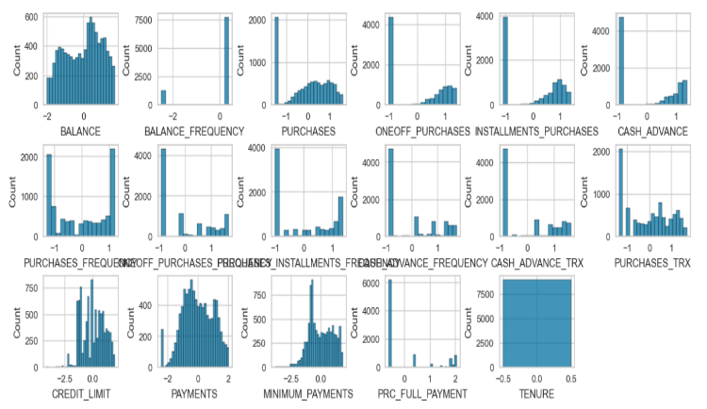
2.2.1-Distribution of The Data with Power Transformer (PT)
After way1 of handling Nan values and PT
After way2 of handling Nan values and PT
The data is almost normal distributed

Slide 34
2.3 Dimensionally reduction

Slide 35
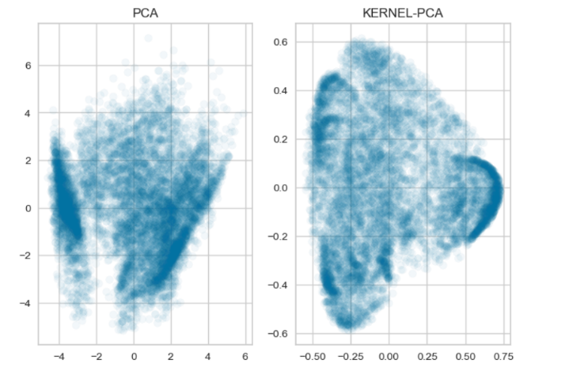
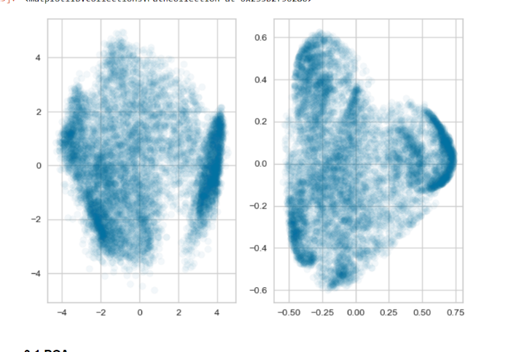
PCA vs Kernel-PCA
With way 1
With way 2
K_PCA looks more better than PCA

Slide 36
3-Modeling

Slide 37
3.1 KMeans

Slide 38
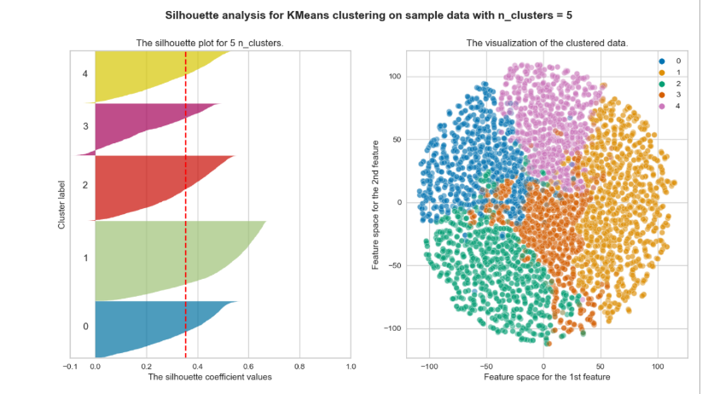
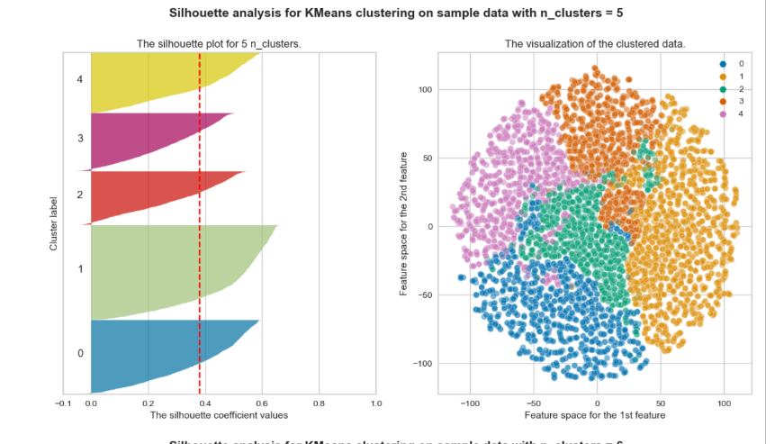
Way 2
Way 1
5 clusters With Score: 35.1
5 clusters With Score: 38.1

Slide 39
3.2 AgglomerativeClustering

Slide 40
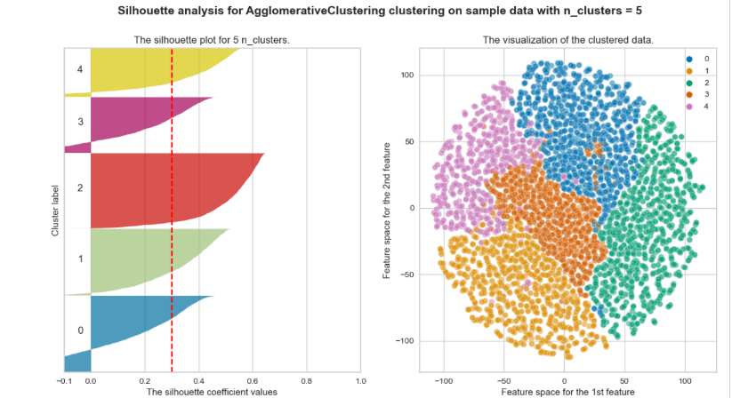
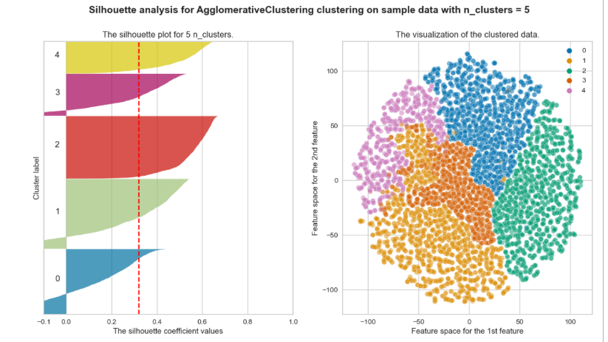
Way 2
Way 1
5 clusters With Score: 30.0
5 clusters With Score: 32.0

Slide 41
3.3 Gaussian Mixture

Slide 42
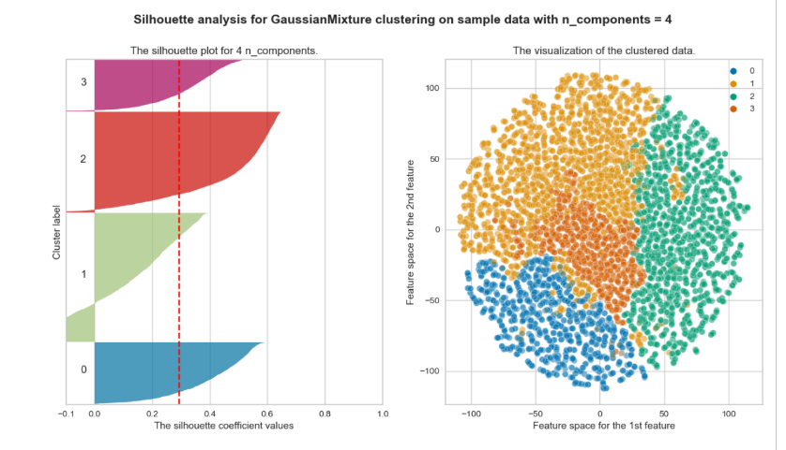
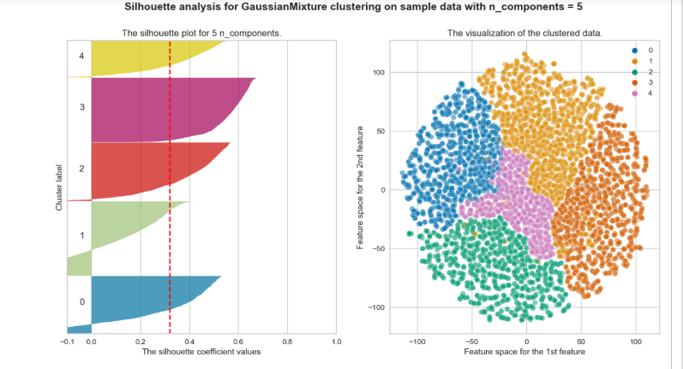
Way 2
Way 1
4 clusters With Score: 29.4
5 clusters With Score: 32.0

Slide 43
3.3 Mean shift

Slide 44
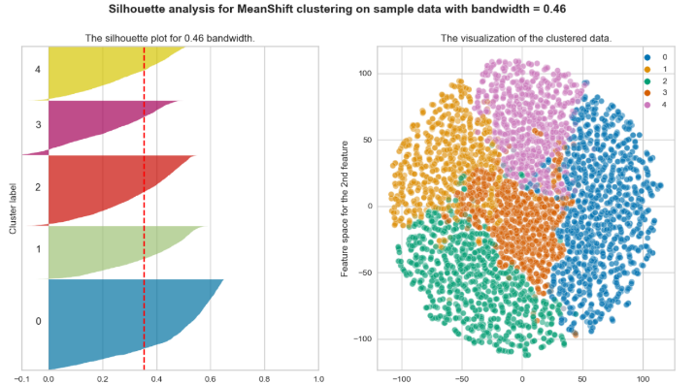
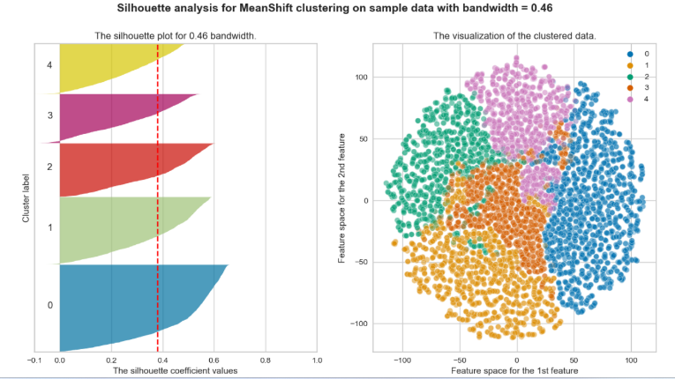
Way 2
Way 1
.46 Bandwidth With Score: 35.4
.46 Bandwidth With Score: 38.0

Slide 45
3.3 DBSCAN

Slide 46
DBSCAN’s silhouette is so bad for the both ways as it’s less than zero

Slide 47
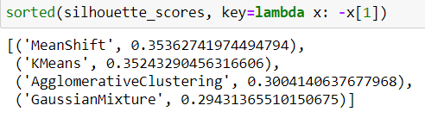
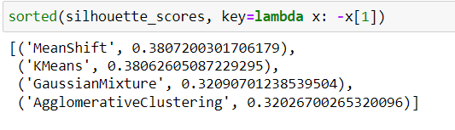
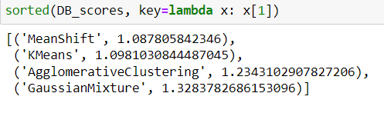

So What Best Model for STD scaler?
Silhouette score vs Davies-Bouldin
Silhouette must be large and DB must be small for the best model
Way 1
Way 2
Way 1
Winner models:
Mean shift Mean shift

Slide 48
Conclusion
Way 2 scores more better than way scores and the best model for both is Mean shift
The Best model is Mean Shift with silhouette score 38.07 and davies_bouldin score = 1.09

Slide 49
2.2.3 Log Transformer

Slide 50


2.2.1-Distribution of The Data with Log Transformer (Log)
After way1 of handling Nan values and Log
After way2 of handling Nan values and Log
The data is almost normal distributed but there little skewness

Slide 51
2.3 Dimensionally reduction

Slide 52


PCA vs Kernel-PCA
With way 1
With way 2
PCA looks more better than K-PCA

Slide 53
3-Modeling

Slide 54
3.1 KMeans

Slide 55


Way 2
Way 1
5 clusters With Score: 44.1
5 clusters With Score: 46.5

Slide 56
3.2 AgglomerativeClustering

Slide 57


Way 2
Way 1
5 clusters With Score: 41.3
5 clusters With Score: 45.5

Slide 58
3.3 Gaussian Mixture

Slide 59


Way 2
Way 1
6 clusters With Score: 44.1
6 clusters With Score: 45.5

Slide 60




So What Best Model for STD scaler?
Silhouette score vs Davies-Bouldin
Silhouette must be large and DB must be small for the best model
Way 1
Way 2
Winner models:
KMEANS KMEANS

Slide 61
Conclusion
Way 2 scores more better than way scores and the best model for both is Kmeans
The Best model is KMEANS with silhouette score 46.59 and davies_bouldin score = .82

Slide 62
Conclusion
The Best model is way 2 , log scaler with Kmeans

